Slide 1
NATURAL LANGUAGE PROCESSING & DEEP LEARNING PROJECT
Automatic Text Summarization Using Transformers
State-of-the-Art Abstractive Summarization with Hugging Face BART & Streamlit

Slide 2

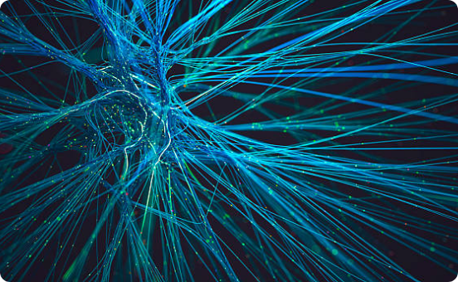
Executive Summary
Project Goal & Vision
End-to-end deep learning system designed to condense unstructured articles into key insights without losing core semantic meaning.
Model Core: Fine-tuned BART CNN Transformer architecture.
Deployment: Interactive Streamlit web interface.
Validation: Automated ROUGE evaluation scores.

Slide 3
Problem Statement & Need
Addressing information overload in digital content consumption.
80%
5x
100%
Unstructured Text Data: Vast volumes of unorganized web articles and documentation.
Time Loss: Manual reading and extraction consumes substantial cognitive bandwidth.
Semantic Retention: Need for automated tools that preserve key factual data.

Slide 4
System Architecture
UI Layer
Model Layer
Evaluation
Streamlit Web Interface
Hugging Face BART Pipeline
ROUGE Metrics Suite

Slide 5
Core Model Selection
MODEL ARCHITECTURE
facebook/bart-large-cnn
Type: Seq2Seq Transformer
Tokenizer: BartTokenizerFast
A sequence-to-sequence encoder-decoder model specifically fine-tuned on CNN/DailyMail dataset for high-quality abstractive text generation.
Dataset: CNN / DailyMail Corpus

Slide 6
Technologies & Tools Used
Component | Technology / Library
Language | Python 3.11
Framework | PyTorch & Hugging Face Transformers
Web UI | Streamlit Framework
Evaluation | rouge-score Library

Slide 7
Evaluation & Performance
ROUGE-1
ROUGE-2
ROUGE-L
Unigram Overlap Assessment
Bigram Overlap Assessment
Longest Common Subsequence

Slide 8
Thank You!
Questions & Discussion
Project: Automatic Text Summarization Using Transformers

Slide 9

Image Sources
https://media.istockphoto.com/id/2231370411/photo/futuristic-digital-neural-network-technology-background.jpg?s=612x612&w=0&k=20&c=je4wC0OxVAWPNxtdBGv-GLKU6qecb-dStBBXlvP-MvY=
Source: www.istockphoto.com

